Slide 1

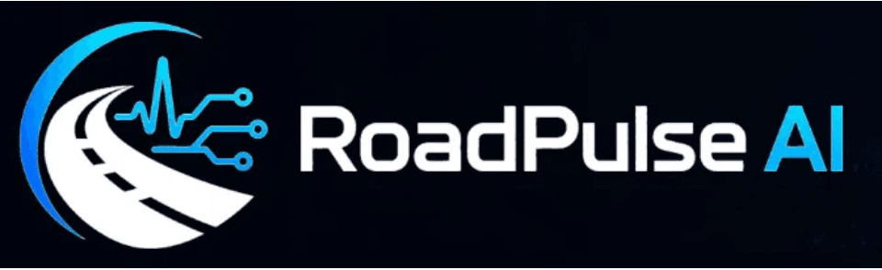
Change The Future
Zaid Alshobaki
Mohammad Alkharabsheh
Kosay Elkady
Reem Albanna
CONNECTED ROAD & DRIVER SAFETY INTELLIGENCE
Intelligence that understands the driver
and remembers the road.
JSYP 2026 Hackathon
Final Presentation · Transportation Sector
RoadPulse-AI · Change The Future
01 / 10
Notes:
Every journey leaves an observable signal about both the driver and the road ahead. RoadPulse-AI turns this raw signal into clear understanding so operations supervisors can make better decisions. We built a complete working prototype that connects hardware, software, and AI into a unified supervisor platform. Duration estimate: forty-five seconds. Transition: Let us begin with the core operational problem faced during every single trip.

Slide 2

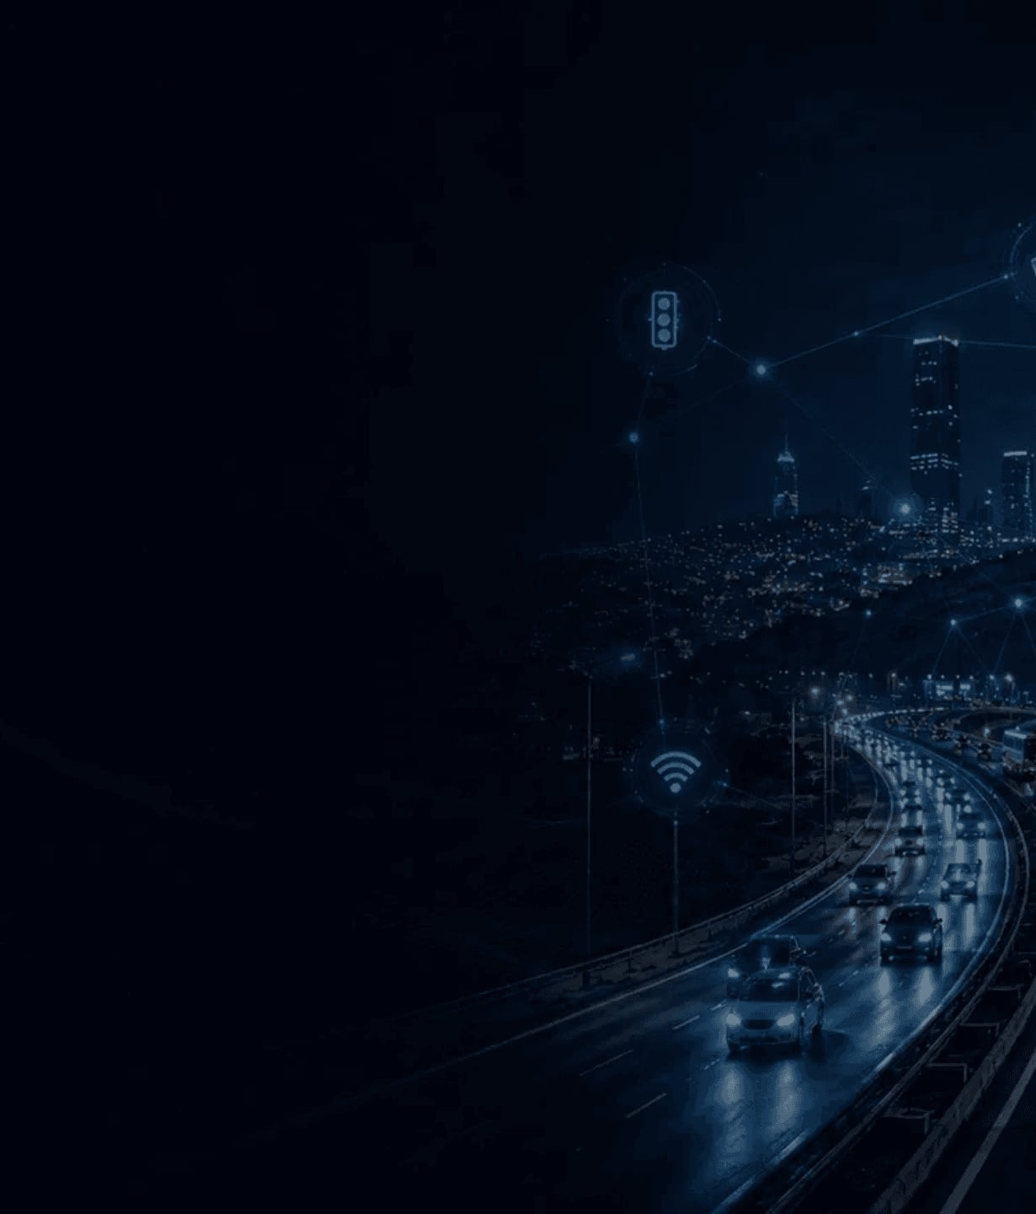
WHY IT MATTERS ?
The event is not the explanation
Telemetry shows what happened. Operations still need to know why.
01
A sudden event does not reveal its cause.
02
The driver or the road may be responsible.
03
Context turns readings into evidence.
04
Supervisors need clarity during every trip.
Driver behavior — or road condition?
01 / THE PROBLEM
RoadPulse-AI · Change The Future
02 / 10
Notes:
Traditional systems record speed and shock, but they don't explain the root cause. A harsh brake or sudden turn leaves supervisors guessing whether the driver reacted or the road forced the reaction. We must bridge this gap to turn raw numbers into actionable insight. Duration estimate: fifty seconds. Transition: From here, we designed a system that connects physical measurement directly to operational context.

Slide 3

02 / THE SOLUTION
One product turns every trip into evidence
Vehicle sensing, reliable transfer, AI analysis, and supervisor action — connected end to end.
01
Capture
02
Extract
03
Connect
Motion + location
Meaningful events
Reliable transfer
04
Validate
05
Analyze
06
Supervise
Backend context
AI + Road Memory
Evidence for action
Result: understood event · likely cause · evidence for review
RoadPulse-AI · Change The Future
03 / 10
Notes:
Our solution treats every trip as a continuous pipeline from the vehicle up to the supervisor dashboard. The device captures motion, extracts meaningful events, runs intelligent analysis, and delivers an understood event with a clear cause. Duration estimate: fifty seconds. Transition: And this complete chain starts with a small, robust device running right inside the vehicle.

Slide 4

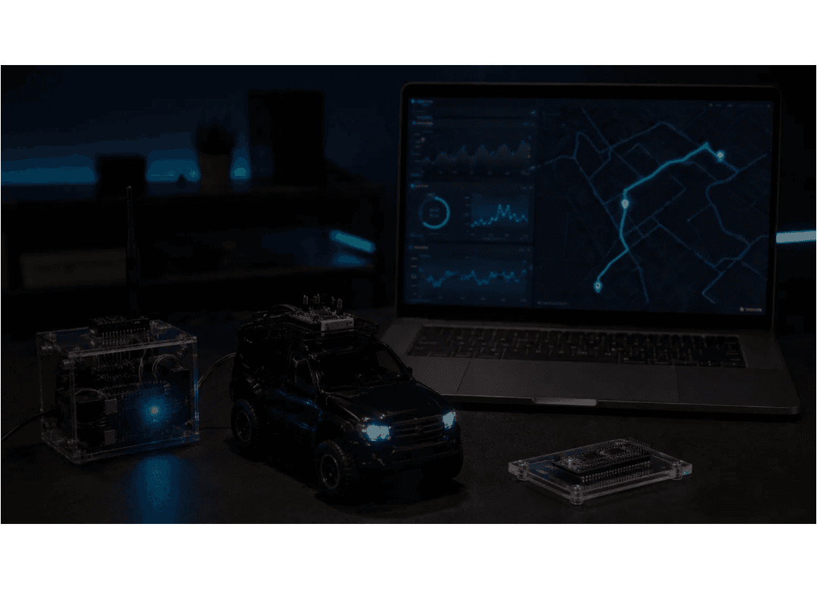
03 / WORKING PROTOTYPE
Compact hardware.
Connected platform.
The prototype captures the signals needed to understand each event.
ESP32 Controller
Connectivity and edge logic.
IMU Sensor
Acceleration and motion signals.
GPS / GNSS
Location, speed, and route context.
MicroSD + Tamper
Offline storage and tamper status.
RoadPulse AI = IoT + AI
RoadPulse-AI · Change The Future
04 / 10
Notes:
We built a working prototype using an ESP32 controller, precise IMU motion tracking, and reliable GPS positioning. Local storage and tamper protection ensure data continuity even when the vehicle loses cellular connection. Duration estimate: fifty-five seconds. Transition: After capturing these physical measurements, the data begins its journey through the entire platform.

Slide 5

04 / DATA JOURNEY
From vehicle signals to a supervisor decision
One connected path keeps each event traceable from sensing to action.
01
02
03
04
05
06
07
Vehicle
Signals
Link
Backend
Database
AI
Dashboard
Motion + GPS
Clean readings
Secure events
Validate + store
Trip context
Classify cause
Evidence
CONTINUITY
TRACEABILITY
Local buffering protects records during interruptions.
Every result stays linked to trip, location, and model.
RoadPulse-AI · Change The Future
05 / 10
Notes:
The system extracts key events right at the edge and relies on local buffering to survive network dropouts. When connectivity returns, all records sync seamlessly to the backend for accurate supervisor review. Duration estimate: fifty-five seconds. Transition: But moving data is only half the battle; real value emerges when our models interpret the event.

Slide 6

05 / INTELLIGENCE
AI explains the event — not just the reading
Features, context, and repeated evidence produce an operational classification.
01 · FEATURES
Extract the signal
Motion · speed · GPS · timing
Driver-related
Likely caused by risky driving behavior.
02 · CONTEXT
Read the pattern
Isolated vs. recurring conditions
Road-related
Supported by recurring road evidence.
03 · EVIDENCE
Show the reasoning
Confidence· explanation· memory
Unresolved
Not enough evidence for one cause.
AI supports the decision — human judgment remains final.
RoadPulse-AI · Change The Future
06 / 10
Notes:
And data transport alone isn't enough; the intelligence layer turns that data into actionable understanding. We don't just log raw numbers or rely on simple thresholds. The model reviews motion features, spatial context, and historical patterns to classify likely causes. And remember, this is a decision-support tool, not an automated final judgment. Let's look at how this all comes together on the supervisor screen.

Slide 7

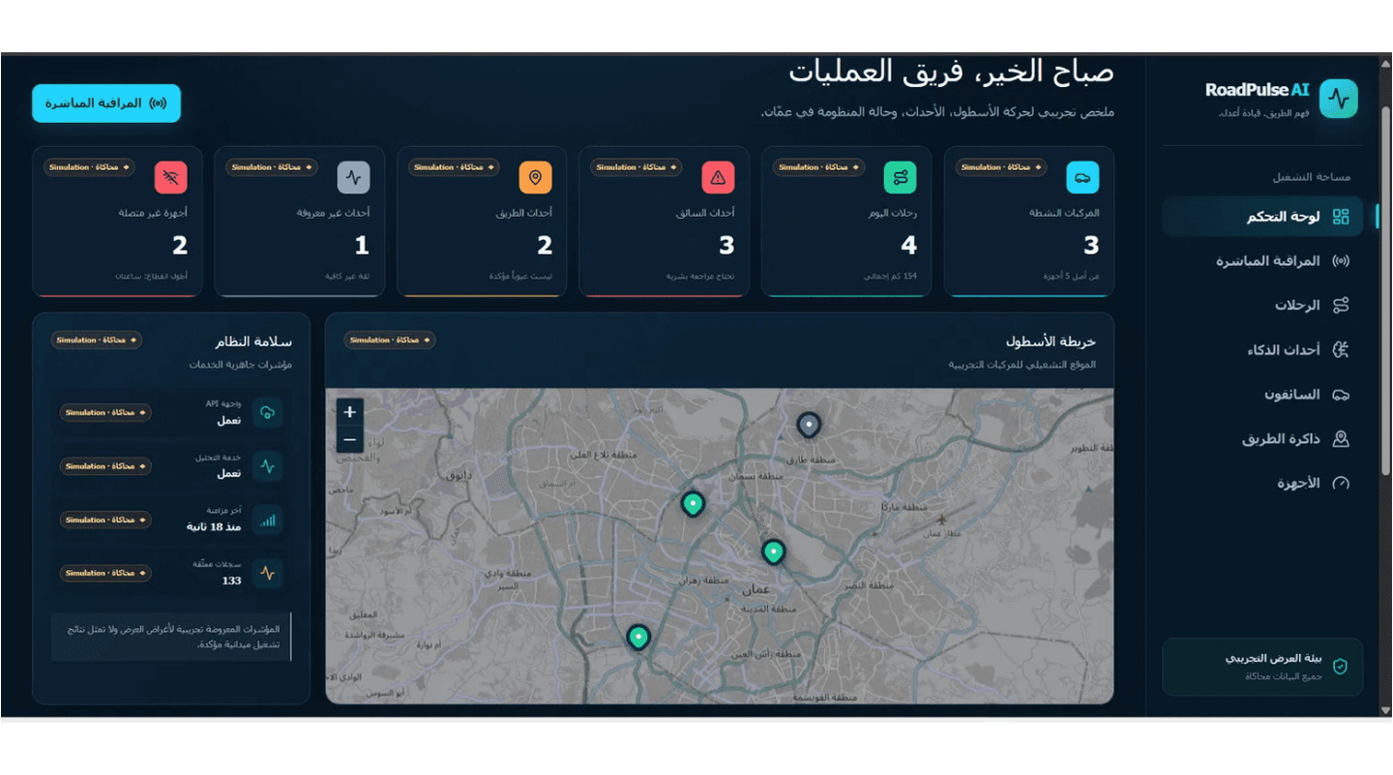
06 / SUPERVISOR INTERFACE
One dashboard. One operational picture.
Fleet Overview
Vehicles, trips, events, and connectivity.
Live Monitoring
Location, speed, event, and likely cause.
Event Details
Severity, confidence, source, and explanation.
System Health
GPS, storage, sync, and tamper status.
RoadPulse-AI · Change The Future
07 / 10
Notes:
Building on that intelligence, the supervisor dashboard brings the entire operational picture into one view. You get real-time fleet overview, live tracking, and granular event details. Every alert clearly separates the reading from its interpretation and source status. It gives dispatchers the exact context they need for follow-up. Now, let's see how this entire loop executes in practice.

Slide 8

07 / LIVE DEMONSTRATION
Signal in. Operational response out.
A repeatable live story: signal, event, intelligence, supervisor, action.
01
02
03
04
05
Device reading
Event detected
AI analysis
Supervisor result
Follow-up
Motion or location changes.
A risk event is identified.
Context and evidence are reviewed.
Cause and confidence appear.
Review the trip
or road.
Current scope: supervisor awareness through the dashboard.
RoadPulse-AI · Change The Future
08 / 10
Notes:
Moving from architecture to reality, here is how our prototype handles an active event. We start with a physical sensor reading, detect the harsh motion, process it through our backend, and display the AI classification. Supervisors get a complete trail from raw signal to recommended action. Let's examine what this means for transport operations across the region.

Slide 9

08 / IMPACT
Practical value for fleets and transport in Jordan
RoadPulse-AI turns reactive reporting into evidence-based prevention.
01
Operational understanding
Understand events and risks during every trip.
Evidence-based supervision
02
Give teams reviewable evidence for follow-up.
Road hazard knowledge
03
Reveal locations where hazards repeatedly occur.
Scalable transport use
04
Extend across vehicles, fleets, and services.
Impact: every trip adds to a growing operational picture.
RoadPulse-AI · Change The Future
09 / 10
Notes:
For fleets and transport networks in Jordan, this changes how we manage road risk. We move away from blind reactive reporting toward evidence-based supervision. Dispatchers gain accumulated knowledge about recurring hazards on specific road segments. And the whole system is built to scale across diverse fleets. Today, this is a working prototype with a clear vision forward.

Slide 10


09 / CONCLUSION & VISION
Working today. Ready to scale.
PRODUCT TODAY
NEXT DIRECTION
• Hardware connected to the platform.
• Expand to more vehicles and fleets.
• Motion and location readings live.
• Improve models with accumulated data.
• Likely-cause event classification.
• Support operators and authorities.
• Clear supervisor dashboard.
• Scale Road Memory across the network.
RoadPulse-AI — vehicle signals into safer decisions
Thank you — Any Questions ?!
RoadPulse-AI · Change The Future
10 / 10
Notes:
To wrap up, what we have built today is a working prototype connecting hardware, backend, and an intelligent dashboard. Next, we scale this to broader fleets and deepen our road memory across the network. We are ready to take your questions and show you the system in action.

